Slide 1



Paper Title: Predicting Heart Disease Using Machine Learning
Paper ID:204
Presenter’s Name, Affiliation: Hardik Dulani, Author
1
International Conference on Machine Intelligence, Tools and Applications (ICMITA-2024)

Slide 2
Authors
Naman Gupta
Gagan Verma
Uday H Nambissan
Harshit Jaiswal
Abhishek Gupta
Hardik Dulani
Supervisor:
Dr. Gopal Singh Tandel
Assistant Professor grade-2,
SCSE, VIT Bhopal
2
International Conference on Machine Intelligence, Tools and Applications (ICMITA-2024)

Slide 3
Introduction
Problem Statement:
Cardiovascular disease (CVD) pose a global threat, with mortality projected to reach 23.3 million by 2030
Coronary artery disease (CAD) accounts for approximately 610,000 deaths annually (estimated 1 in 4 deaths). It is the third leading cause of mortality worldwide and is associated with 17.8 million deaths annually.
Solution Overview:
Early detection of cardiovascular disease (CVD) or coronary artery disease (CAD) can help patients receive timely interventions to prevent complications and improve outcomes
Our ML models with explainable AI determine the necessity of medical tests for CVD or CAD in patients, aiding in proactive healthcare decision-making
2
International Conference on Machine Intelligence, Tools and Applications (ICMITA-2024)

Slide 4
Literature Review
Study 1:
It focused on predicting 3-year all-cause mortality in heart failure patients due to coronaryheart disease (CHD) using extreme gradient boosting (XGBoost) models and SHapley Additive explanations(SHAP) for interpretability
Future directions include diverse dataset validation, clinical integration, and continuous model refinemen
Study 2:
it explored environmental parameters' interactions with CVD, utilizing Random Forest (RF) models and SHAP for understanding climate impacts on cardiovascular health
Future considerations involve extending the study's timeframe, replicating it in different locations, and proposing policies for adapting to changing climate conditions
2
International Conference on Machine Intelligence, Tools and Applications (ICMITA-2024)

Slide 5
Literature Review
Study 3:
It utilized a haematology Electronic Health Record (EHR) dataset, employing RF, XGBoost, and AdaBoost models for AHD prediction with SHAP interpretation
It also addresses the prevention of arteriosclerotic heart disease (AHD)
Study 4:
It aimed to develop a robust predictive model for general cardiovascular disease (CVD) using a voting ensemble technique
2
International Conference on Machine Intelligence, Tools and Applications (ICMITA-2024)

Slide 6
System Architecture
About Dataset:
We are using the Z-Alizadeh Sani dataset that is publicly available in the UCI Machine Learning repository.
This dataset comprises 303 medical records from 303 patients who sought treatment for chest pain at Shaheed Rajaei Hospital in Iran.
There are 55 features total in each record, divided into four groups.
(1) Demographic features, (2) Symptoms and Physical Examination, (3) ECG, and (4) Echocardiography features.
The data will be preprocessed and divided into training and test sets.
Additionally, we will use SMOTENC to oversample thedata and Optuna to create predictive models with hyperparameter customization. In this study 303 samples wereused in the dataset that belong to two classes, namely, CAD class and normal class.
When the stenosis of coronary arteries lumen of a sample reaches or exceeds 50%, this sample is classified as CAD class;
otherwise, it belongs to the normal class .
Link: https://archive.ics.uci.edu/dataset/412/z+alizadeh+sani
2
International Conference on Machine Intelligence, Tools and Applications (ICMITA-2024)

Slide 7
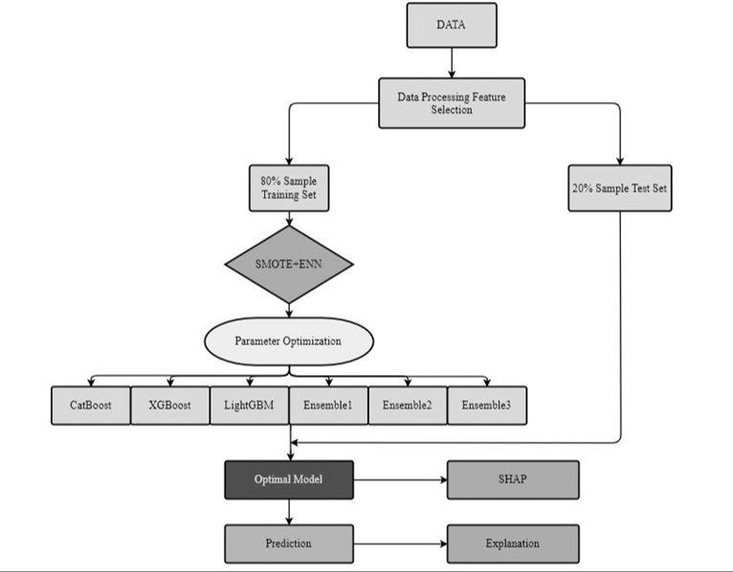
System Architecture
2
International Conference on Machine Intelligence, Tools and Applications (ICMITA-2024)

Slide 8
Methodology
Eleven models will be built: Gaussian Naïve Bayes, Logistic Regression, Decision Trees, Extreme Gradient Boosting, Support Vector Machine, Random Forest, Light Gradient Boosting Machine, Cat Boost, and three Ensemble models.
Models will be evaluated using accuracy, precision, recall, F1 score, and roc_auc score.
CatBoost focuses on efficient gradient boosting for categorical features, minimizing the need for preprocessing.
XGBoost optimizes for speed and efficiency in a regularized gradient boosting framework, supporting parallel computing.
LightGBM uses a histogram-based learning approach for efficient and scalable processing of large datasets.
Gaussian Naïve Bayes applies Bayes' Theorem with independence among predictors, assuming Gaussian feature distribution.
2
International Conference on Machine Intelligence, Tools and Applications (ICMITA-2024)

Slide 9
Methodology
Logistic Regression models the probability of class membership via the logistic function for binary classification.
Decision Trees classify by partitioning the feature space into simple decision rules derived from the data.
Support Vector Machine seeks the optimal separating hyperplane to maximize the margin between classes.
Random Forest combines multiple decision trees to improve predictions, reducing overfitting risks.
Ensemble models improve predictive performance by combining multiple model predictions, including techniques like bagging and boosting.
An optimal model will be selected for explainability analysis using the SHAP model.
2
International Conference on Machine Intelligence, Tools and Applications (ICMITA-2024)

Slide 10
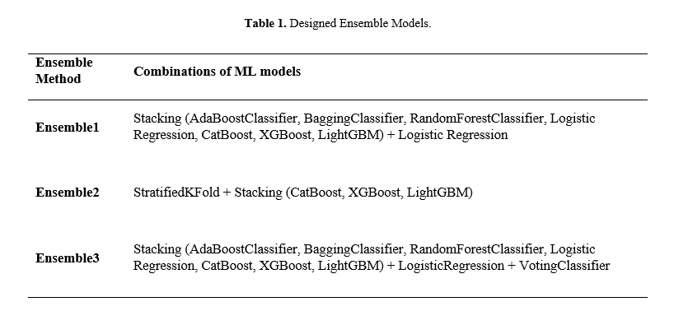
Methodology
2
International Conference on Machine Intelligence, Tools and Applications (ICMITA-2024)

Slide 11
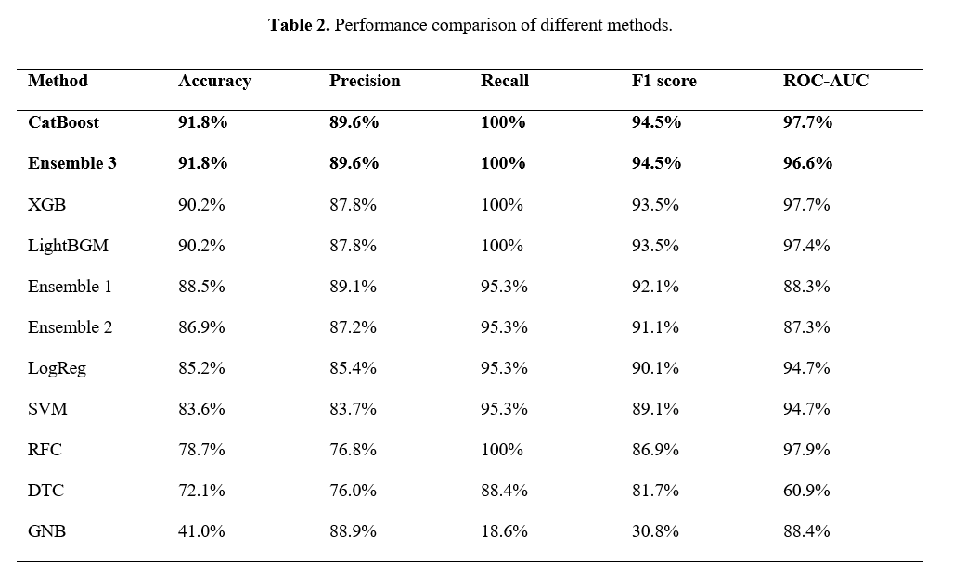
Results
2
International Conference on Machine Intelligence, Tools and Applications (ICMITA-2024)

Slide 12
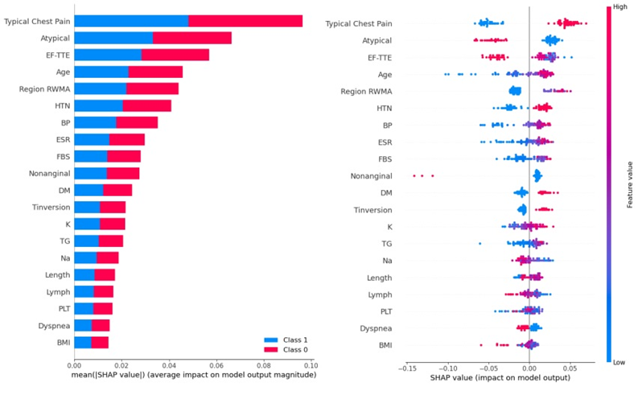
Results
2
International Conference on Machine Intelligence, Tools and Applications (ICMITA-2024)

Slide 13
Results
Top Models:
CatBoost
Ensemble 3
Top Features:
Typical Chest Pain
Atypical chest pain
Ejection fraction
Age
Regional Wall Motion Abnormality
2
International Conference on Machine Intelligence, Tools and Applications (ICMITA-2024)

Slide 14
Thank You
2
International Conference on Machine Intelligence, Tools and Applications (ICMITA-2024)

